Slide 1

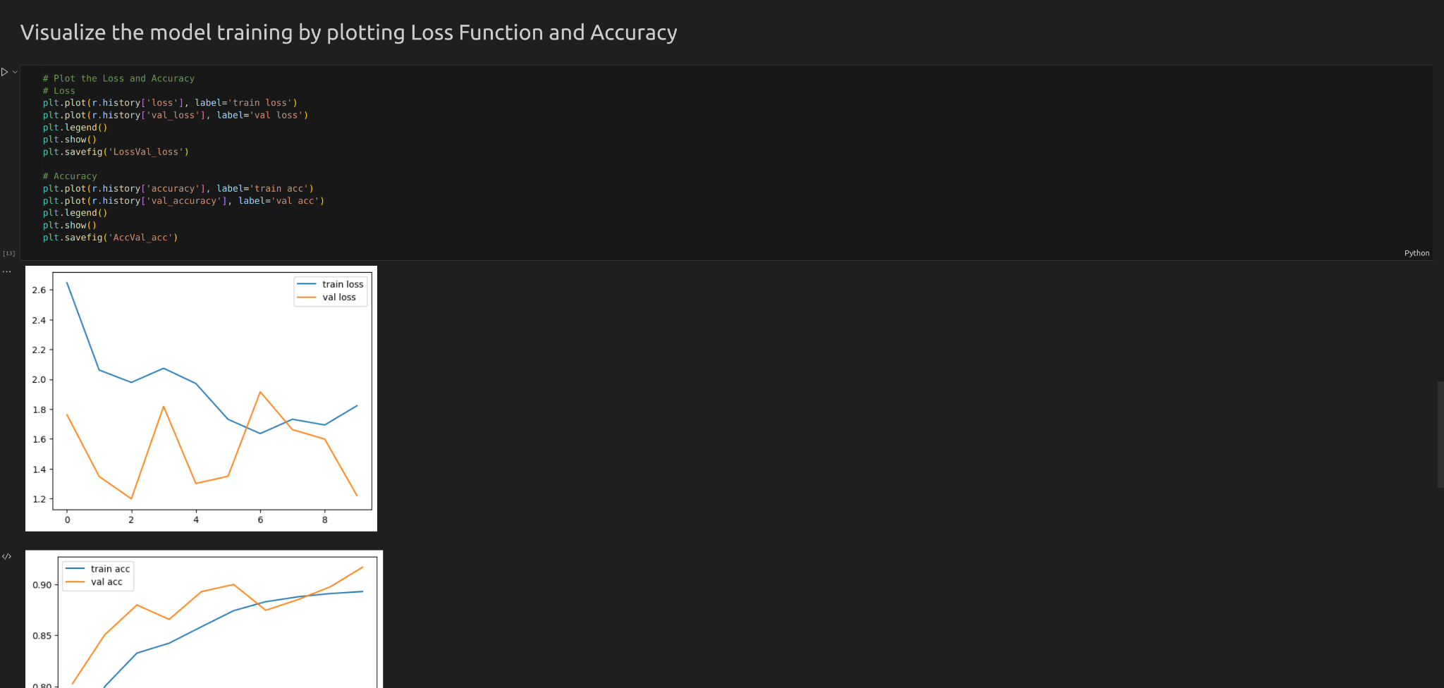
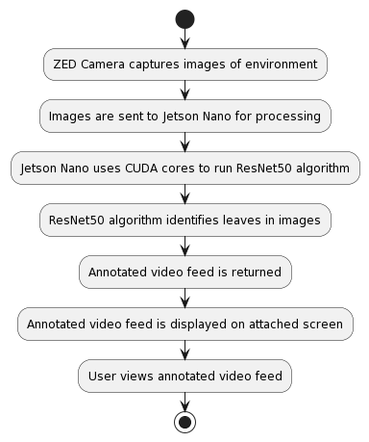
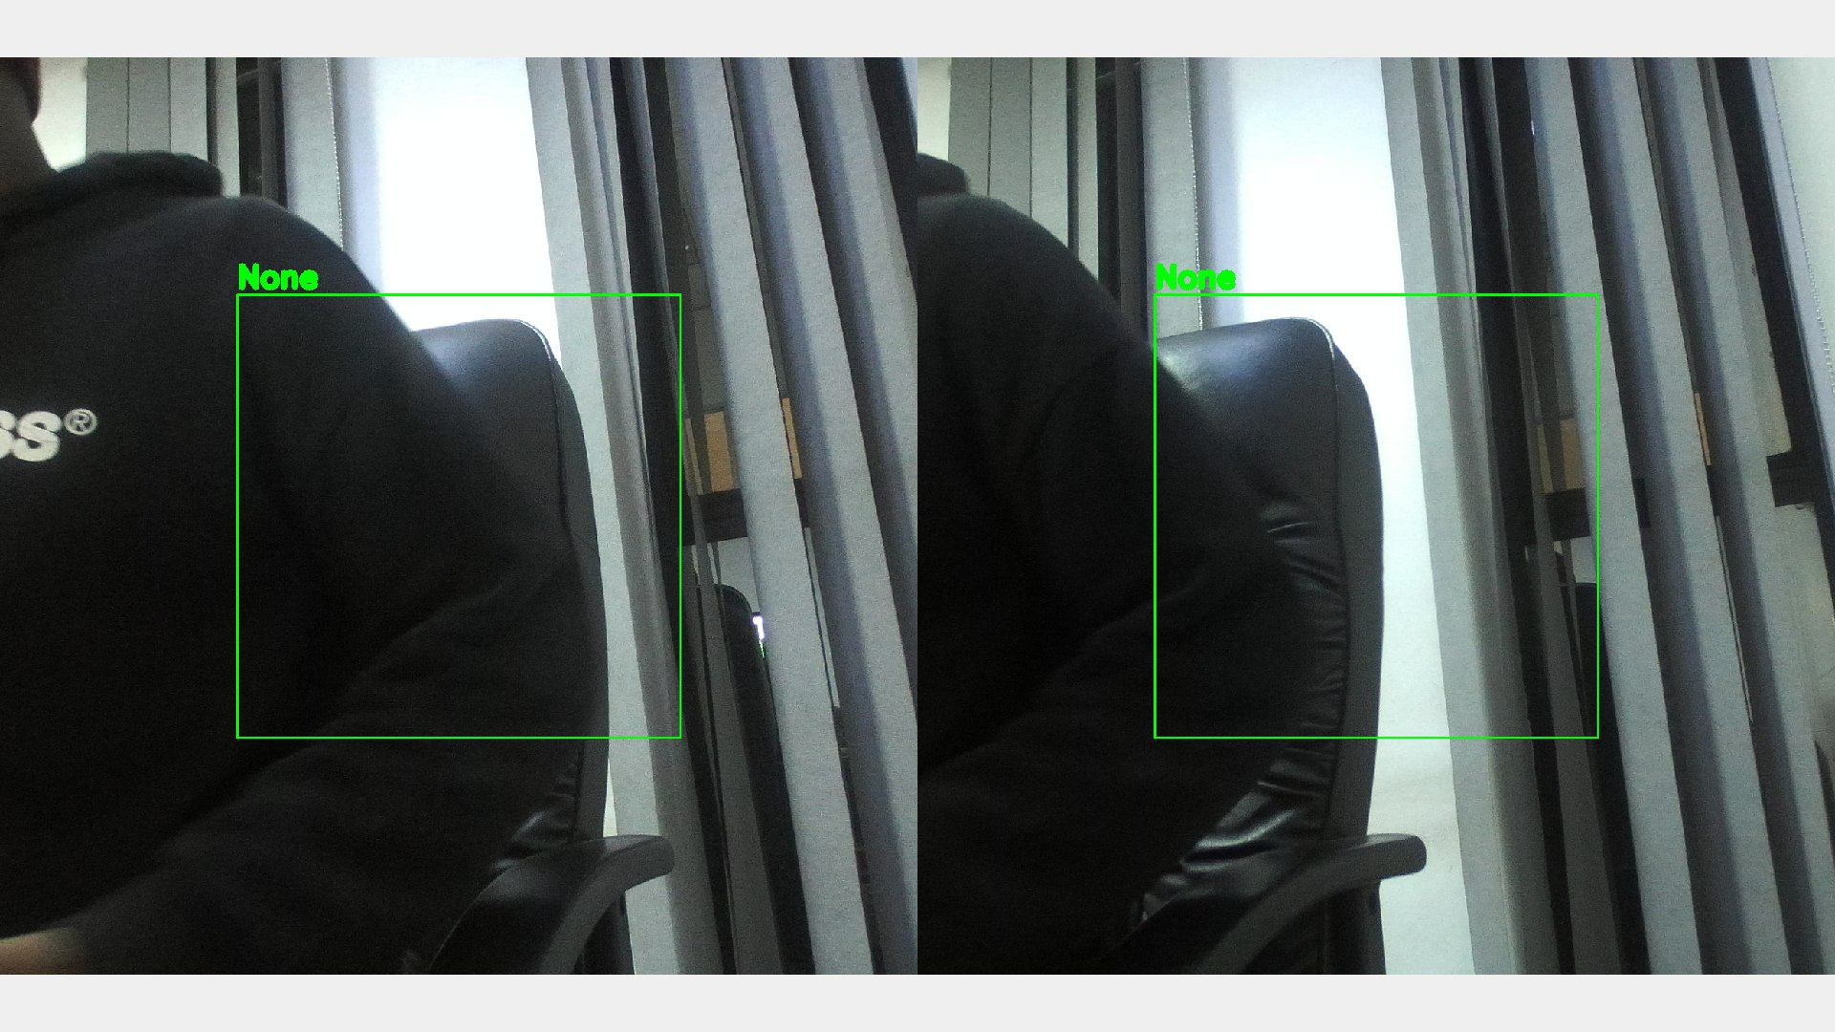
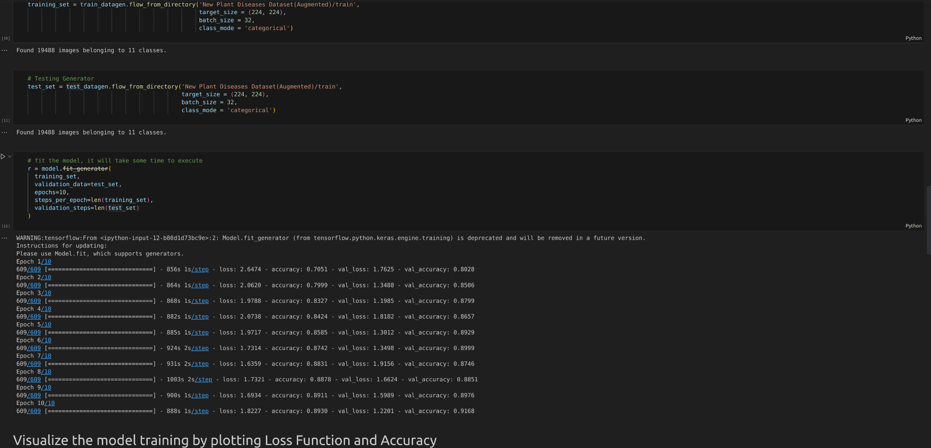
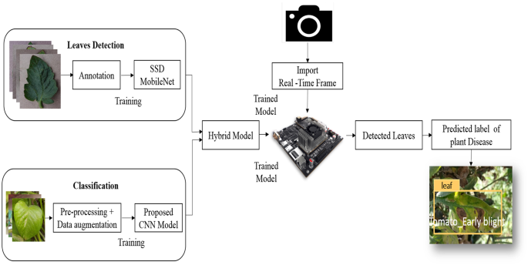
Disease Detection System: A Technology-Based Approach to Plant Disease Management
kelvin Zawala - Software Engineering Department
1.0 Abstract
3.0. Problem definition
7.0. activity diagram
Disease Detection System is a technology-based system designed to recognize and detect diseases in plants using advanced computer vision techniques and convolutional neural networks (CNNs). This system is primarily developed to improve the detection and management of plant diseases in farms and greenhouses. In this paper, we present the design and implementation of the Disease Detection System, including its two main components: the disease recognition component and the disease interpretation component. We also discuss the potential benefits and applications of this system in improving plant disease management.
Population and wealth growth over the next half-century will result in a massive increase in food consumption. To achieve this predicted growth without huge acreage expansion, agricultural yields must dramatically rise. Crop yields are significantly influenced by the insect and disease challenges farmers encounter, as well as the remedies available. Control strategies rely on the accurate identification of illnesses and causative agents. Illness control procedures can be a waste of time and money if the disease and the disease-causing agent are not properly identified. This can lead to additional plant losses. As a result, accurate illness diagnosis is critical. As a farmer scales up production assessment of crops for diseases becomes hard. The farmer may fly over fields but this requires a lot of skill and risks errors.
2.0. Introduction
Conclusion
Protecting plant health is essential to all industries. Plants not only contribute to the global food system but also provide non-food crops for energy, fiber, fodder and horticulture. Plant diseases are defined as physiological functions of plants stimulated by existing plant pathogens (organisms or infectious agents). Global crop losses are estimated at $220 billion per year, accounting for 14.1% of losses caused by diseases. Culture failure can be caused not only by abiotic factors such as the environment but also by organisms such as oomycetes, fungi, viruses, bacteria, nematodes, and bacteria. Plant diseases reduce product quality and shelf life of crops, reduce the nutritional value of fruits and vegetables, reduce yield, damage aesthetics and make some crops unsaleable.
Today, agricultural planes are high-tech equipment. They've come a long way since the early days of the Tiger Moth and the shawls outside the window. Turbine aircraft today are highly productive and efficient and everything is computerized. They are very expensive but can cover a large area in a short time. An aircraft costs are broken into two areas:
Fixed costs: These are costs incurred every year, regardless of the amount of work performed. This includes insurance, interest, pilot wages, and some maintenance. That means a plane has to do a lot of work every year to reduce those costs per hectare. One example is insurance which currently costs about $1,000 a week whether we work or not. If we do 1,000 hectares per week, it will be $1 per hectare. If we do 4000 hectares then $0.25c.
The variable costs: This is the cost per hour to operate the aircraft. If the aircraft is stationary, these costs are not incurred. For example fuel and maintenance. These costs are quite high and range from $10 to $15 per minute. This means that when an aircraft is in flight, it should cover as many hectares per hour as possible.
A combination of the fixed and variable costs makes using an agricultural plane very expensive in mass crop assessment, that is checking crops for diseases. On top of that, it requires a lot of skill and experience to tell which plants are sick from an aerial view of the crop.
4.0. Overview of the developed application
The Disease Detection System is a technology-based approach to plant disease management that has the potential to significantly improve the detection and management of plant diseases in farms and greenhouses. The system’s use of advanced computer vision techniques and CNNs enables it to accurately recognize and detect various plant diseases, while its interpretation component provides valuable information about the detected diseases and suggests possible treatment options. With its potential benefits for improving plant disease management, this system represents an important step forward in leveraging technology for sustainable agriculture.
The Disease Detection System comprises one main component: the disease recognition component. The recognition component is responsible for recognizing and detecting diseases in plants.
Disease Recognition Component The recognition component of the system uses a Jetson Nano as the computer of choice, utilising its CUDA cores to run advanced CNNs such as ResNet50. The system is trained on a large dataset of plant images to enable it to accurately recognize and detect various plant diseases.
The recognition process begins with the acquisition of images of plants using a camera attached to the Jetson Nano. These images are then pre-processed to enhance their quality and fed into the CNN for disease recognition. The CNN analyzes the images and outputs a prediction of whether or not a disease is present in the plant.
8.0. Screenshots
Supervisor – Ms. Yolanda Chibaya
5.0. Objectives
To provide a feasible solution that is mobile and can be attached on numerous vehicles.
To give predictions of affected areas that over 70% close to the ground truth result
To have a setup that requires 2 times less power than traditional scan setups
To use 3 times less resources than the traditional `Basant to Air Tractor`
To have a setup that requires at least 2 times less power than traditional scan setups
6.0. System Overview

